Slide 1
AS91883(1.7) & AS91884(1.8) Documentation
Thomas Xu

Slide 2
Māori numbers 1-10
Link to GitHub Repository: https://github.com/mgsthomasxu/Maori_numbers_1-10
Links to Trello board / project management tools: https://trello.com/b/tm4PdfmB/maorinumbers1-10
Link to final version of your program: [here]
Ensure you have made these links ‘public’ so that they are open to anyone, including the marker. The link to your program is the final outcome of this whole project – your finished program.

Slide 3
Describe relevant Implications:
Additional rows can be added by clicking in the last cell and then using the Tab key
Relevant implication | Describe the implication and give an example
Functionally | Features are about making sure the program works as expected. It should work for expected, borderline and unexpected situations. For example, if my program asks the user how many rounds they want, it should work fine for expected input (like "2") or boundary input (like "1"), but if the user enters something invalid (like "0" or "0.5") "), it should not crash or "a"
usability | Usability is about how early the end user can get the program to do what it's supposed to do. It addresses issues such as making instructions and error messages legible and easy for users to understand. It is important to minimize or eliminate any frustration.
aesthetic | Aesthetic is about the program’s overall appearance. A program which looks good because it includes well spaced instructions, prompts and ‘decoration’ around key messages is going to be more aesthetically pleasing than one which is composed of unspaced plain text
Notes:
Additional rows can be added by clicking in the last cell and then using the Tab key

Slide 4
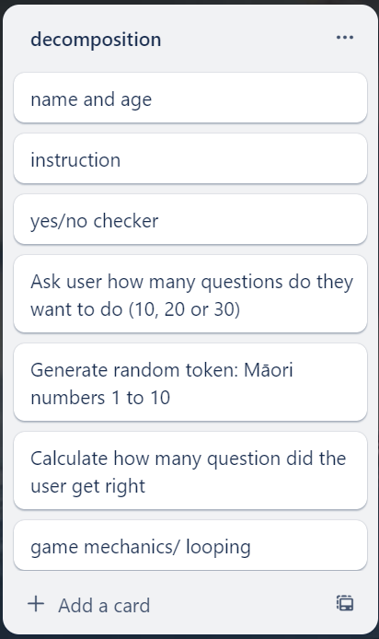
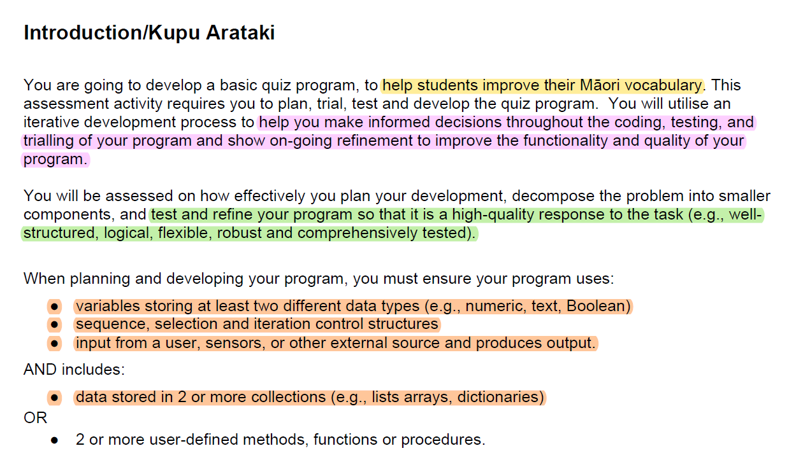
Decomposition:
Paste screenshots of your initial Trello board / task decomposition on this slide. If you have a long list, you might need to break it up into several slides.
Notes:
Paste screenshots of your initial Trello board / task decomposition on this slide. If you have a long list, you might need to break it up into several slides.

Slide 5
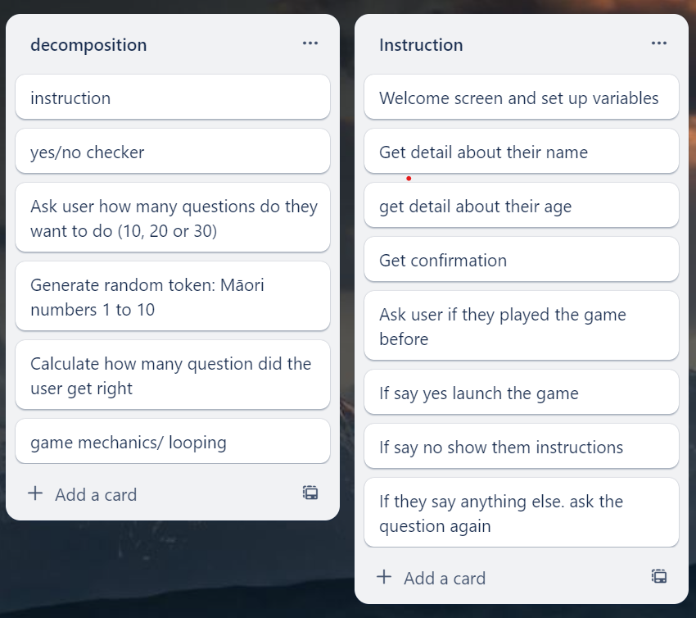
[Component 1] (Instruction&yes/no checker)

Slide 6
[Instructions] - Test Plan
Additional rows can be added by clicking in the last cell and then using the Tab key
Test Cases - input | Expected output
Have you played this game before? Maybe | <error> please choose Yes/No
Have you played this game before? Maybe | Game Starts
Have you played this game before? Maybe | Show instructions, then start the game
Notes:
Additional rows can be added by clicking in the last cell and then using the Tab key

Slide 7
[Yes/No checker] - Test Plan
Additional rows can be added by clicking in the last cell and then using the Tab key
Test Cases - input | Expected output
Yes | Program continues
Y | Program continues
No | Program continues
N | Program continues
Maybe | Please enter either “Yes” or “No”
Notes:
Additional rows can be added by clicking in the last cell and then using the Tab key

Slide 8
[Component name]: Trialling
NOTE: Trialling needs to happen for at least 2 of your components but is not necessary for ALL components.
Trialling is not the same as testing. Trialling is about finding different ways of building the same component. Show evidence of your trialling here. Select one of your trials for further development and give reasons for your choice.
Notes:
NOTE: Trialling needs to happen for at least 2 of your components but is not necessary for ALL components.
Trialling is not the same as testing. Trialling is about finding different ways of building the same component. Show evidence of your trialling here. Select one of your trials for further development and give reasons for your choice.

Slide 9
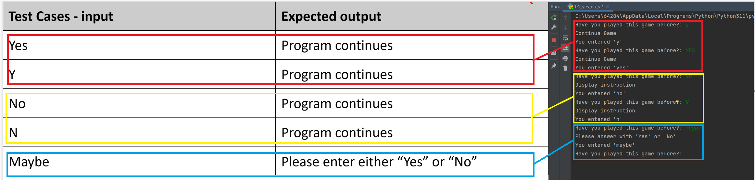
[Yes/No checker]: Testing
You must show the results of testing. For each component, include a screenshot proving it works. You can also include notes about each test.
All test cases worked as expected
Notes:
You must show the results of testing. For each component, include a screenshot proving it works. You can also include notes about each test.

Slide 10
Assembled Outcome Testing:
Show testing for your assembled outcome below. This should include a test plan followed by screenshot proof.
Notes:
Show testing for your assembled outcome below. This should include a test plan followed by screenshot proof.

Slide 11
Address relevant Implications:
Relevant implication | Explain how your final outcome addresses each implication
Functionality | I have comprehensively tested my outcome to ensure that the functionality implication has been address (i.e. it works for expected, unexpected and boundary values).
Usability | The inclusion of optional instructions and clear error messages helps to make the outcome easy to use.
Aesthetics | I have carefully spaced the program's output and used a statement generator to enhance its appearance. Whilst aesthetics is not the main focus of text based programs, ensuring the outcome looks good also helps address the usability implication.
Social | My program has a $10 limit on the amount users can spend. This addresses the social implications of gambling by making it difficult for users to spend an excessive amount of money.
Future proofing | I avoided the use of literals and used functions to make my code flexible and easy to modify later if necessary. The code is well set out and commented so that another programmer can make changes easily at some future time.

Slide 12
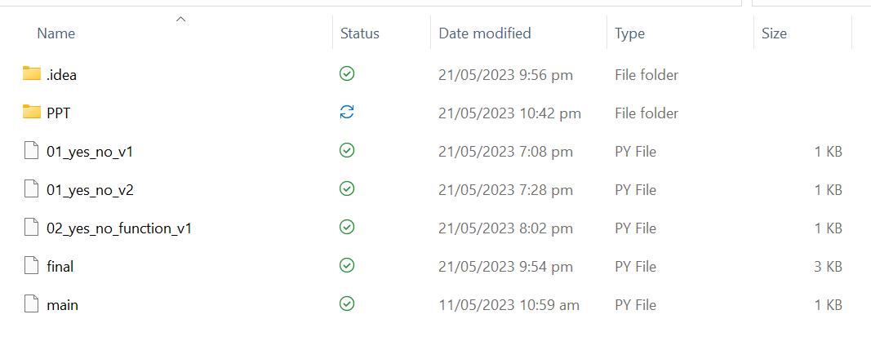
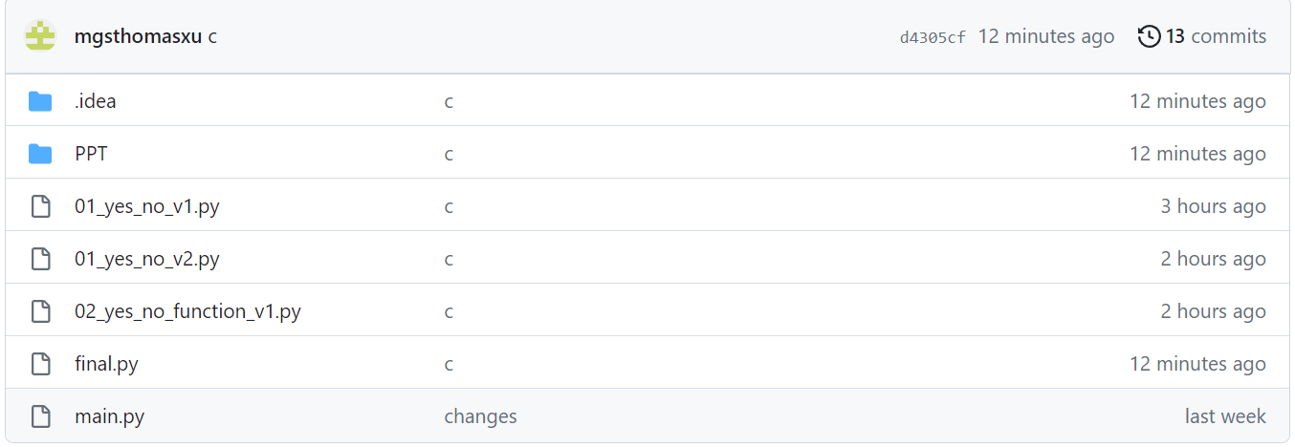
Version Control Evidence:
Your version control evidence should go here. This could be in the form of screenshots (both of your GitHub repository as well as your local project folder) as evidence of your incremental development.
Notes:
Your version control evidence should go here. This could be in the form of screenshots (both of your GitHub repository as well as your local project folder) as evidence of your incremental development.

Slide 13
Final Discussion:
Discuss how the information from planning, testing and trialling of components assisted in the development of a high-quality outcome.
I tested my code using https://www.pythonchecker.com/ to make sure that it met the conventions regarding spacing Layout (see the next slide)
Notes:
Discuss how the information from planning, testing and trialling of components assisted in the development of a high-quality outcome.

Slide 14
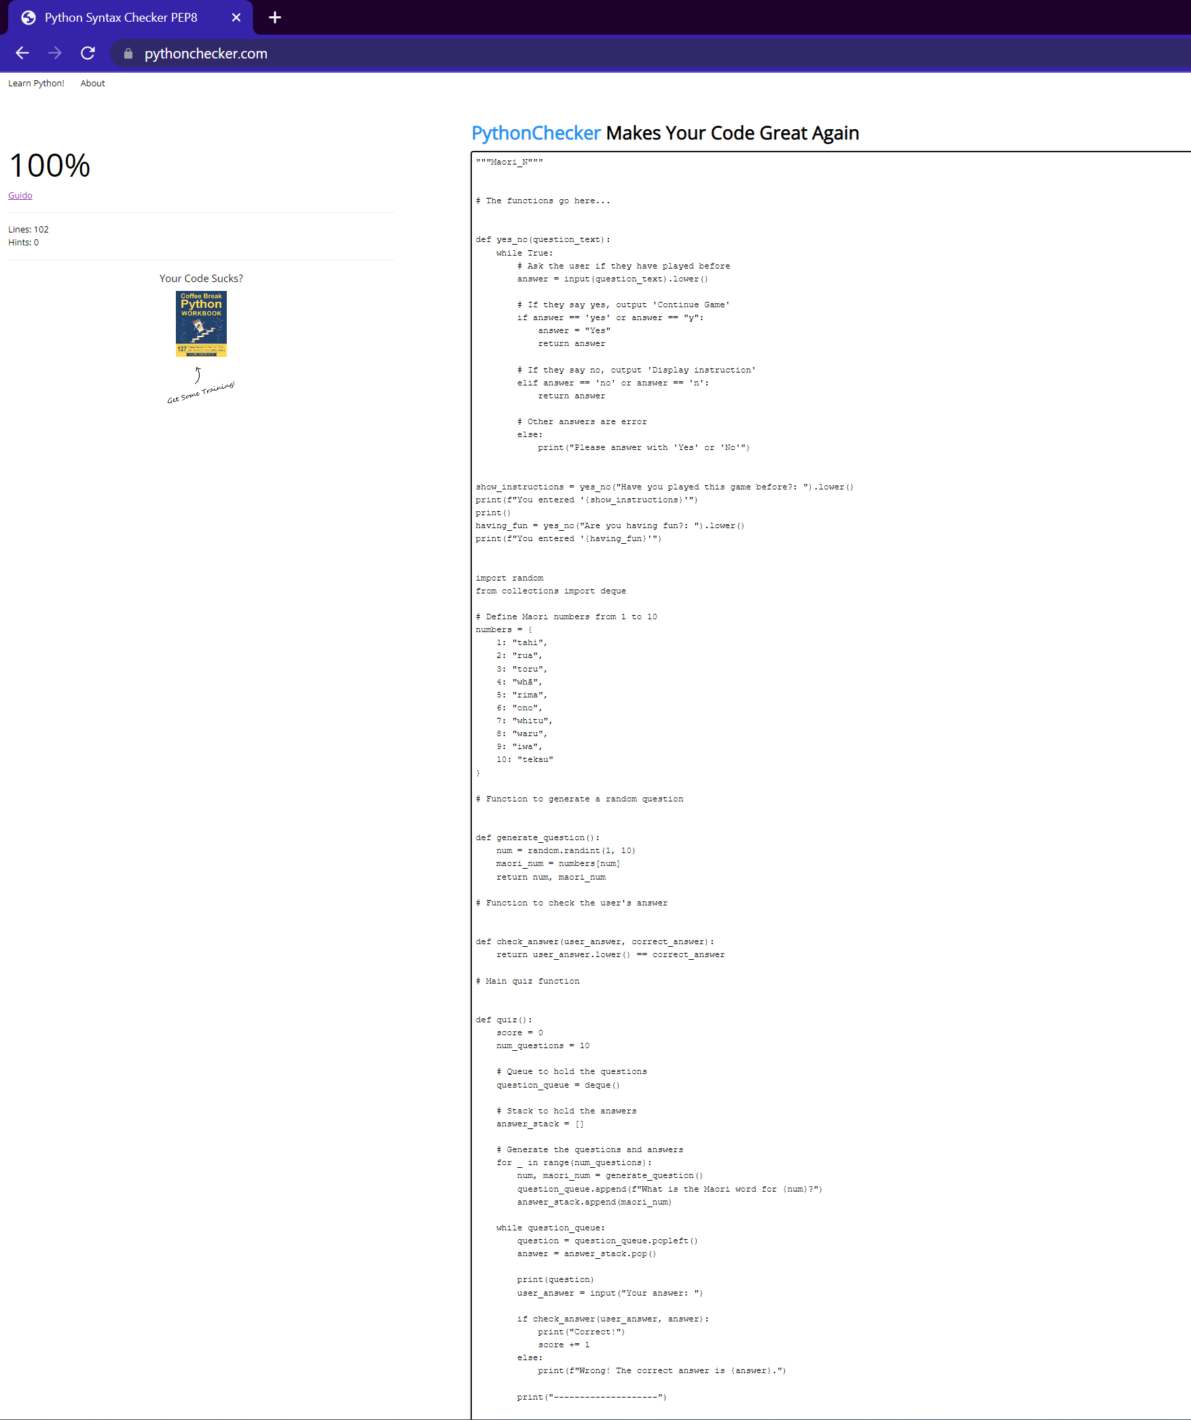
Evidence of meeting pep8 requirement

